Slide 1
Design Patterns in .Net
Real world use of design patterns in .Net applications
Notes:
Welkom blablabla

Slide 2
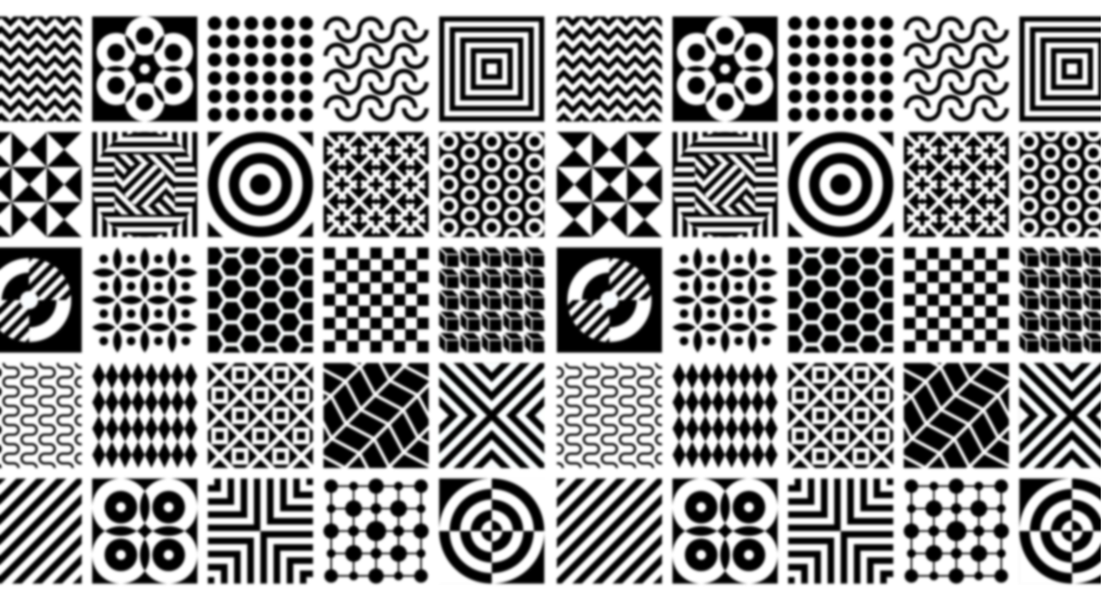
Notes:
Ladies and gentlemen, imagine a world where every architectural marvel, from the towering skyscrapers of New York to the serene temples of Kyoto, follows a set of universal principles. These principles, known as design patterns, provide architects with a language of solutions to recurring challenges in their craft. But what if I told you that this concept didn't just stay within the realm of buildings and bridges? What if it transcended into the very codes and algorithms that power our digital world?

Slide 3


Notes:
In 1977, Christopher Alexander, an architect with a keen eye for patterns, introduced a revolutionary idea in his book 'A Pattern Language.' He proposed a language centered around entities called patterns—timeless solutions to architectural problems found across different cultures. These patterns weren't just bricks and mortar; they were the building blocks of universal design thinking.

Slide 4


Notes:
Fast forward to 1995, a landmark year for software engineering. Four visionaries—Erich Gamma, Richard Helm, Ralph Johnson, and John Vlissides—crafted a masterpiece: 'Design Patterns: Elements of Reusable Object-Oriented Software.' This book, also known as the 'Gang of Four' (GoF) bible, brought the concept of design patterns into the digital age. Drawing inspiration from Alexander's work in architecture, they observed how software development teams faced similar challenges. Just as a blueprint guides an architect, these design patterns became the blueprint for software engineers, guiding them through the complexities of code.

Slide 5
What is a design pattern?
Notes:
But what exactly is a design pattern? Imagine it as a roadmap, not for physical structures, but for the structures of code itself. These are tried-and-tested solutions to common programming problems, offering a clear path through the maze of software development. From object composition to class structure, design patterns in languages like C# provide a framework for developers to create more readable, maintainable, and efficient code.

Slide 6



Kjell Coppin
Notes:
Hello, I'm Kjell Coppin, a passionate software engineer with a focus on .NET development. Today, in this TED talk, I aim to empower fellow developers by sharing insights on writing cleaner, more efficient code trough design patterns.

Slide 7
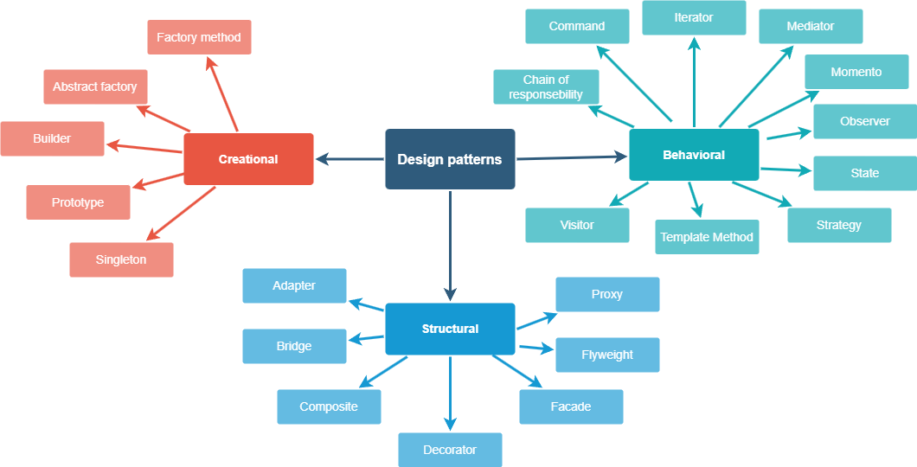
Notes:
In the famous book written by the Gang of four, 3 types of design patterns are talked about.
Creational Patterns: These patterns focus on the process of object creation, providing mechanisms for creating objects in a manner suitable for a given situation. Examples include Factory Method, Abstract Factory, Singleton, Builder, and Prototype patterns.
Structural Patterns: Structural patterns deal with the composition of classes or objects to form larger structures. They help ensure that if one part of a system changes, the entire system doesn't need to do so. Examples include Adapter, Decorator, Proxy, Composite, and Facade patterns.
Behavioral Patterns: Behavioral patterns are concerned with communication between objects, focusing on how objects distribute responsibilities and duties among themselves. Examples include Observer, Strategy, Command, Iterator, and State patterns.

Slide 8
Singleton pattern

Slide 9
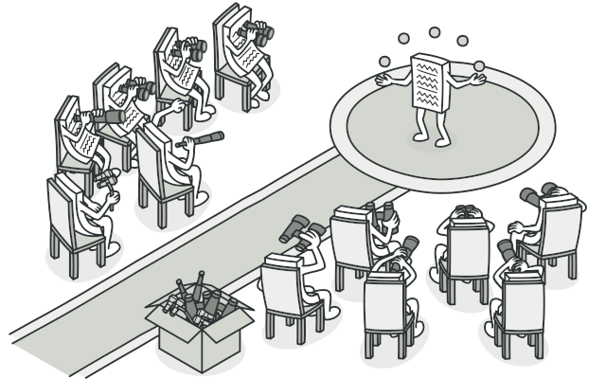
Observer pattern
Figure 1

Slide 10
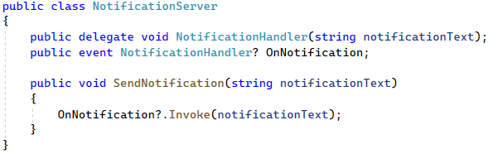
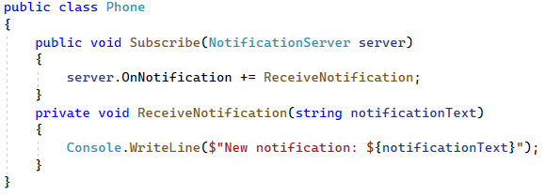
Observer pattern

Slide 11
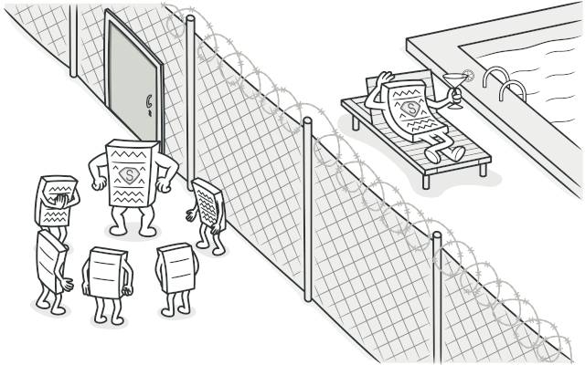
Proxy pattern
Figure 2

Slide 12
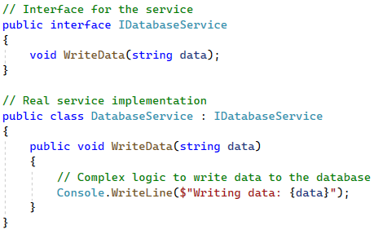
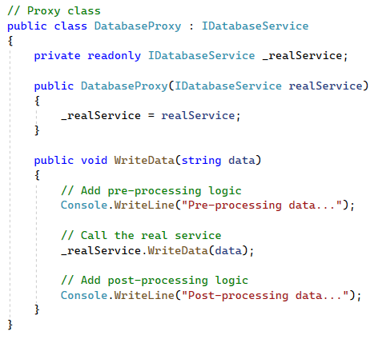
Proxy pattern

Slide 13

Real world usage

Slide 14
Thanks for your attention ofzo
Figure 1: https://refactoring.guru/design-patterns/observer
Figure 2: https://refactoring.guru/design-patterns/proxy

